Slide 1
Introduction
Incident Response

Slide 2
Welcome to South Dakota!
Sioux Falls – South Dakota’s largest city at ~174,000 population in 2016
Capitol in Pierre, center of the state
The Mount Rushmore State
Only a 5.5 hour, 370 mile drive across the state
Dakota State University’s campus in Madison
About 50 miles NNW of here
May be opportunities to visit campus this week if you’re interested

Slide 3

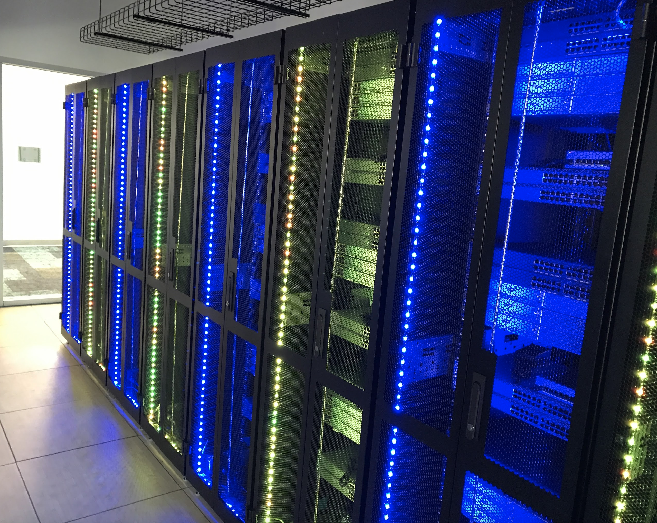
A bit about DSU
Madison, SD
~7500 population
Lake County
Plenty of lakes and outdoor recreation fun
~3300 enrolled, and growing
Fastest growing university in the state
Cybersecurity and Computer Science programs
New buildings on campus
Beacom Institute of Technology
Features a server room dedicated for classroom use
New for 2017-2018
Madison Cyber Labs (MadLabs)
Applied Research facility
Construction began earlier this month

Slide 4
Who are we?
Tyler Flaagan​
Tyler.Flaagan@dsu.edu
Red Team Operator at SPAWAR​
Adjunct Instructor at DSU​
Cyber Security​
Computer Science
Private Security Consultant
D.Sc. Cyber Security (ABD)
DSU Cyber Corps Scholarship
Cody Welu
Cody.Welu@dsu.edu
Assistant Professor at DSU
Cyber Security
Computer Science
Blue Team experience in the Federal Gov’t
D.Sc. Cyber Security (ABD)
DSU Cyber Corps Scholarship

Slide 5
Course Materials
Everyone should have a flash drive
Most of the VMs
In cases where we are using a larger lab environment, we’ll use the IA Lab
Larger environments can be made available via download, let us know after class.
http://rebrand.ly/irworkshopshare
All other resources
PPT slides
Lab documents
Lab materials
Updated throughout the week
Feel free to download + add to flash drive

Slide 6
IA Lab Information
Virtual infrastructure for classroom and student use
Classroom lab environments
Safe space to learn about and execute malware
Enough resources to run multi-VM environments for administration and security classes
Student projects
Great sandboxed environment to play and learn
For this workshop, a great place to run our VMs and larger environments
Largest VMware installation in the state
110 sockets
~5TB RAM
~100TB Storage
…and all growing this summer

Slide 7
Accessing the IA Lab
Just a web browser!
Most modern browsers will probably work (No one uses IE or Edge)
Firefox 32-bit ESR is the officially supported version
Chrome will probably (mostly) work
Firefox will probably (mostly) work
http://learn.ialab.us
Credentials are on your flash drive
readme.txt

Slide 8
General Schedule
Wednesday -> Friday
4 “sessions” each day (breaks in between)
Typically 2 topics each session
Breaks in between each session
8:00 – 9:45AM
10:00 – 11:45AM
1:00 – 2:45PM
3:00 – 4:45PM (Except Friday)

Slide 9
Course Outline
Mix of lecture slides and hands-on lab work
Day 1
Overview
Phases of an IR
Attacker Overview
Indicators and Intelligence
Logs and SIEMs
Day 2
Network monitoring and firewalls
Windows Logs
Filesystem and autorun analysis
IR Data collection
Day 3
Memory analysis
Final hands-on exercise

Slide 10
What is Incident Response?
Incident
“an event or occurrence”
Data breach
Cyber attack
Response
“a reaction to something”
The process one uses to handle a cyber attack or data breach

Slide 11
Why?
Goals of an IR
Limit the scope of the attack as much as possible
Limit the technical damage
Limit the financial damage
Limit collateral damage, like reputation
Quickly restore services
Mitigate vulnerabilities
Ultimately: Stop an intrusion before it causes damage.
Incidents that are not handled tend to escalate into major breaches with potentially major impact
Let’s talk about doing this quickly…

Slide 12
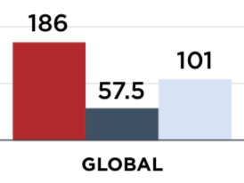
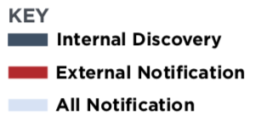
Find bad fast
The sooner we figure out someone is in our network, the better
Then, the sooner we can kick them out
Dwell time – the number of days from the time the adversary initially got in to the time they were detected
Two discovery locations…
Home Depot – 5 months
PF Chang’s – 11 months
OPM – ~1 year
Sony – ~1 year
2018 Mandiant M-Trends

Slide 13
How do you find out?
External Notification
Someone outside of your organization notified you
Law enforcement
External fraud monitoring
News reports
Internal Discovery
Your organization discovered the incident without external assistance
Continuous monitoring programs
Intrusion detection systems
Internal security processes

Slide 14
External Notification
Begin the investigation – determine if the notification is legitimate
Might know what type of data was lost
Might even get a specific IP address
Organizations CANNOT rely on external notification
It’s not guaranteed
It’s probably slow
Visibility is limited compared to internal processes
Misuse of assets – more likely to see internally
Easier to detect an incident BEFORE it turns into a breach or loss of data

Slide 15
Internal Discovery
Generally faster
Can find a breach earlier than if externally notified
Globally, 57.5 days (internal) vs. 186 days (external)
Internal security programs
Security Operations Center (SOC)
Intrusion Detection System
Continuous Monitoring
Threat Hunting
Better visibility into your own network from the inside
Better chance of catching in incident BEFORE it becomes a breach with data loss

Slide 16
Phases of an Incident Response
Includes preparation time, from even before the breach occurs
Identifying the incident
Cleaning up the incident and remediation
A period to look back at the lessons learned during the incident
SANS breaks an incident response down into 6 categories:
Preparation
Identification
Containment
Eradication
Recovery
Lessons Learned

Slide 17
PICERL
Preparation
Everything leading up to the incident
People – who is responsible for doing what?
Communication
Tools, laptops, equipment
Checklists
Identification
What happened?
What systems were affected?
What data was lost?
Containment
Limit the magnitude of the issue
Monitor or shut down/disconnect affected systems
Eradication
Cleaning up the issues
Removing the threat
Patching the vulnerabilities
Recovery
Rebuilding systems
Restoring services
System validation
Lessons Learned
Did the process work?
What can be fixed for next time?

Slide 18
Preparation
Prepare for the worst
…actually create a plan
Checklists
What to do during an incident
Develop a containment policy
Disaster recovery plan
Confirm tool availability
Tools up to date
Operating Systems up to date
Flyaway kits prepared
Technology processes

Slide 19
Preparation
People
Who’s in charge around here?
Technical lead
Senior
Need to be able to make decisions
Lead the response effort
Major stakeholders
Business unit
IT Staff
Sysadmins
Security Staff
Communication
Internal Communication
Constant communication between local and remote support
”War Room” – Center of operations
Update meetings
External Communication
Sometimes this is required
PR Team
A breach can really affect your company’s image

Slide 20
Preparation - Tools
Network Forensics
Snort
Suricata
Sguil
Wireshark
Nmap
Volatility
Virtualization
VMware
Virtual Box
Quality Computers
Power cables, power strips, etc
Network Cables
https://github.com/meirwah/awesome-incident-response

Slide 21
Identification and Investigation
This is really when the incident response starts
Assess the situation
What’s going on?
Does it seem truly malicious?
Classify the incident, and begin further investigation
Level 1 – Unauthorized Access
Level 2 – Denial of Service
Level 3 – Malicious Code
Level 4 – Improper Usage
Level 5 – Scans/Probes/Attempted Access
Level 6 – Investigation Incident

Slide 22
Identification and Investigation
Figure out what systems are involved in the breach
What data was accessed?
Who did it?
Do the logs show anything else?
Data Sources
Copies of the hard drives
Memory
Network device logs
Application logs
System logs
Create IOCs and run them against other systems on the network
Indicators of Compromise

Slide 23
Containment
Once you know what you’re dealing with…
Try to limit the scope and magnitude of the issue
Contain the infection
Three options for containment
Disconnect affected systems
Shut down all systems immediately
Continue to allow the system to run, but closely monitor them
May need to think about keeping critical resources online
Make sure the business unit is aware before you start shutting things down

Slide 24
Eradication
Actually getting rid of the problem
Cleanup
Uninstalling the infected software
Running AV
Rebuilding the entire OS
Patching the vulnerabilities
Notification
Beyond the incident response reporting chain
Bring in other folks who may not be involved with the IR team

Slide 25
Recovery
Returning to normal operations
Restoring services
Redundancy or rebuild
Please, please make sure things are patched
Don’t put a vulnerable system back online that was already compromised once
System validation
Is it operating as expected?
All components are operational
Data is in tact

Slide 26
Lessons Learned/Follow-Up
All about making sure the process worked
Was there enough prep?
Did detection occur in a timely fashion?
Was communication done clearly?
What didn’t go so smooth?
How can we prevent this from happening again?

